Slide 1
Reinforcement Learning
Unsupervised learning of the optimal behavior in an environment to obtain maximum reward.
15th Oct 2021
Internal

Slide 2
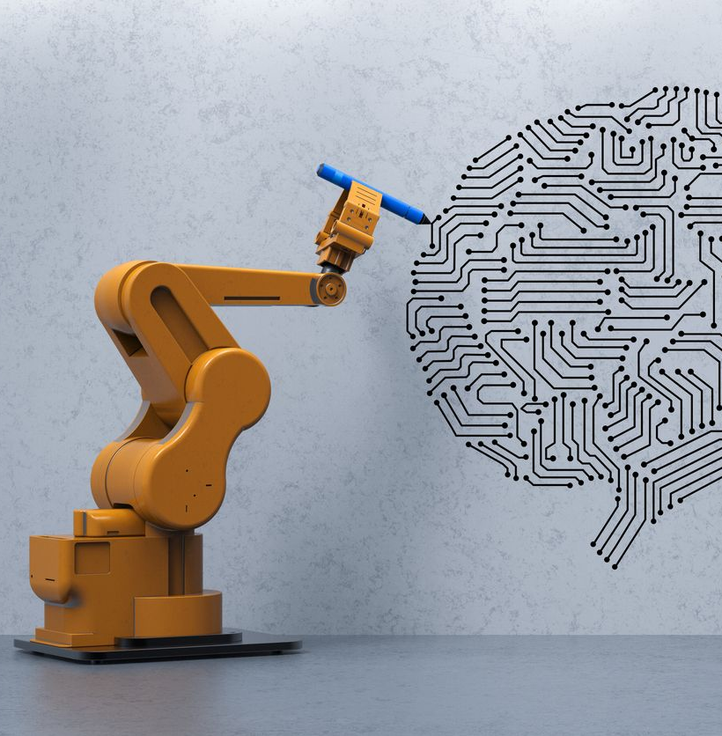
Agenda
[Motivation] Is Reinforcement Learning Worth It?
Example Use Cases of Reinforcement Learning
Key Components of Reinforcement Learning
Reinforcement Learning Techniques
Q-Learning
SARSA
Deep Q-Network
Deep Deterministic Policy Gradient (DDPG)
OpenAI Gym – Framework for RL
Internal

Slide 3
Agenda
[Motivation] Is Reinforcement Learning Worth It?
Example Use Cases of Reinforcement Learning
Key Components of Reinforcement Learning
Reinforcement Learning Techniques
Q-Learning
SARSA
Deep Q-Network
Deep Deterministic Policy Gradient (DDPG)
OpenAI Gym – Framework for RL
Internal

Slide 4
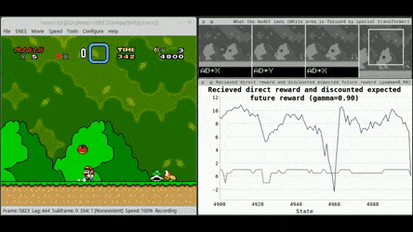
[Motivation] Is Reinforcement Learning Worth It?
What is Reinforcement Learning?
Reinforcement Learning (RL) is the science of decision making.
It is about learning the optimal behavior in an environment to obtain maximum reward.
This optimal behavior is learned through interactions with the environment and observations of how it responds, similar to children exploring the world around them and learning the actions that help them achieve a goal.
I like to think of Reinforcement Learning as a form of Dynamic Optimisation, and in some cases combined with Supervised ML (e.g., Deep Q-Networks).
Advantages
RL is closer to artificial general intelligence (AGI), as it possesses the ability to seek a long-term goal while exploring various possibilities autonomously.
Disadvantages
Despite its strengths, the adoption of RL has been slow in many fields for the following reasons:
Focuses on the problem as a whole
Conventional ML algorithms are designed to excel at specific subtasks, without a notion of the big picture.
RL, on the other hand, doesn’t divide the problem into subproblems; it directly works to maximise the long-term reward.
RL agents need extensive experience
RL methods autonomously generate training data by interacting with the environment. Thus, the rate of data collection is limited by the dynamics of the environment.
Environments with high latency slow down the learning curve.
Does not need separate data collection step
Training data is the learning agent’s experience, not a separate collection of data that has to be fed to the algorithm.
Delayed rewards
In some cases, it is very difficult for the agent to discover the optimal policy due to delayed rewards (e.g., winning a game of chess).
Works in dynamic, uncertain environments
In RL, time matters and the experience that the agent collects is not independently and identically distributed (i.i.d.).
Lack of interpretability
It is (near) impossible to understand the reasons of actions taken by agents, besides observing them under many cases.
Internal

Slide 5
Agenda
[Motivation] Is Reinforcement Learning Worth It?
Example Use Cases of Reinforcement Learning
Key Components of Reinforcement Learning
Reinforcement Learning Techniques
Q-Learning
SARSA
Deep Q-Network
Deep Deterministic Policy Gradient (DDPG)
OpenAI Gym – Framework for RL
Internal

Slide 6
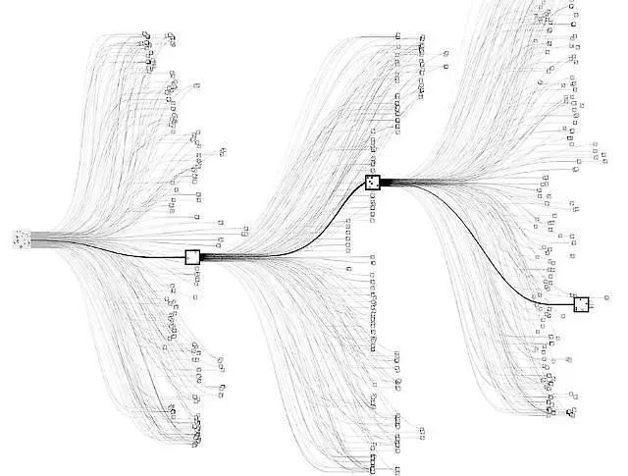
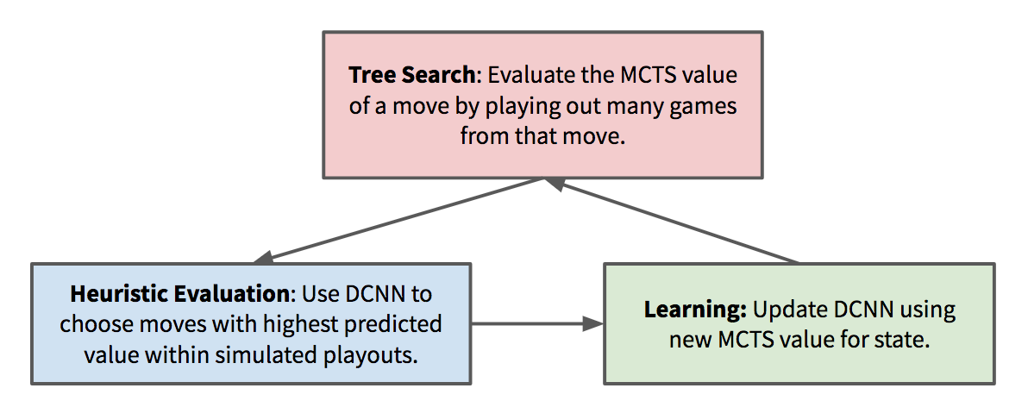
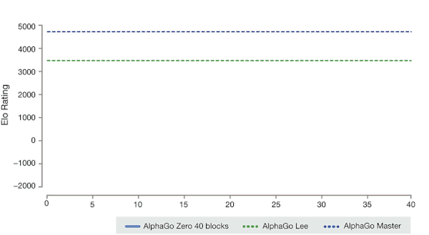
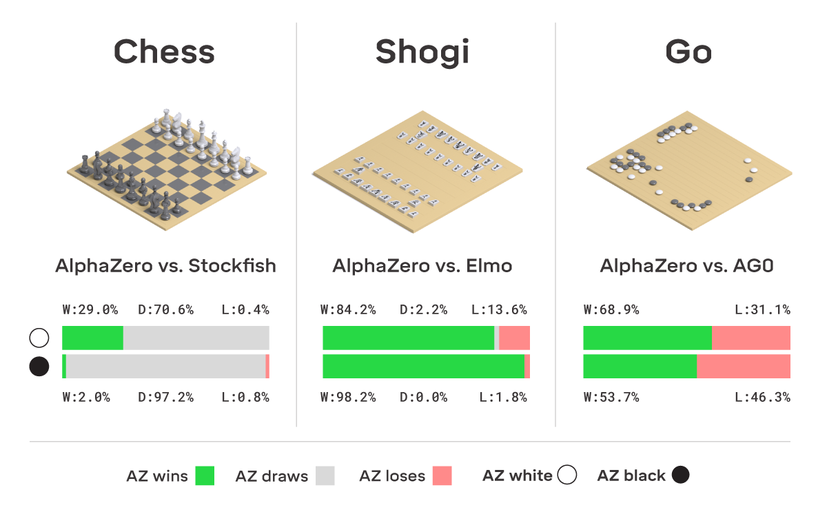
Example Use Cases of Reinforcement Learning
Gaming
One of the prime usages of RL is in gaming. We have various high-end algorithms already existing in the market.
AlphaGo (2015) & AlphaZero (2017) by DeepMind
Mastering the game of shogi, chess, and go.
Techniques involved:
Monte-Carlo Tree Search
Used to reduce the computational cost of depth-first search (DFS).
Uses random exploration to estimate the value of a state.
Upper-Confidence Bounds Applied to Trees (UCT)
Uses a cheap heuristic approximation of the value of a step to estimate its value.
UCT balances exploration and exploitation.
Deep Learning Heuristic Functions
To help cater for “similar situations” which are not recognised by the model (e.g., same piece placements but at different location of the board).
Uses deep convolutional neural networks (DCNN) as fuzzy stores of values.
Monte-Carlo Tree Search
Business, Marketing, and Advertising
Recommendation Systems
Science
AlphaZero Explained · On AI (nikcheerla.github.io)
Internal

Slide 7
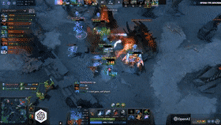
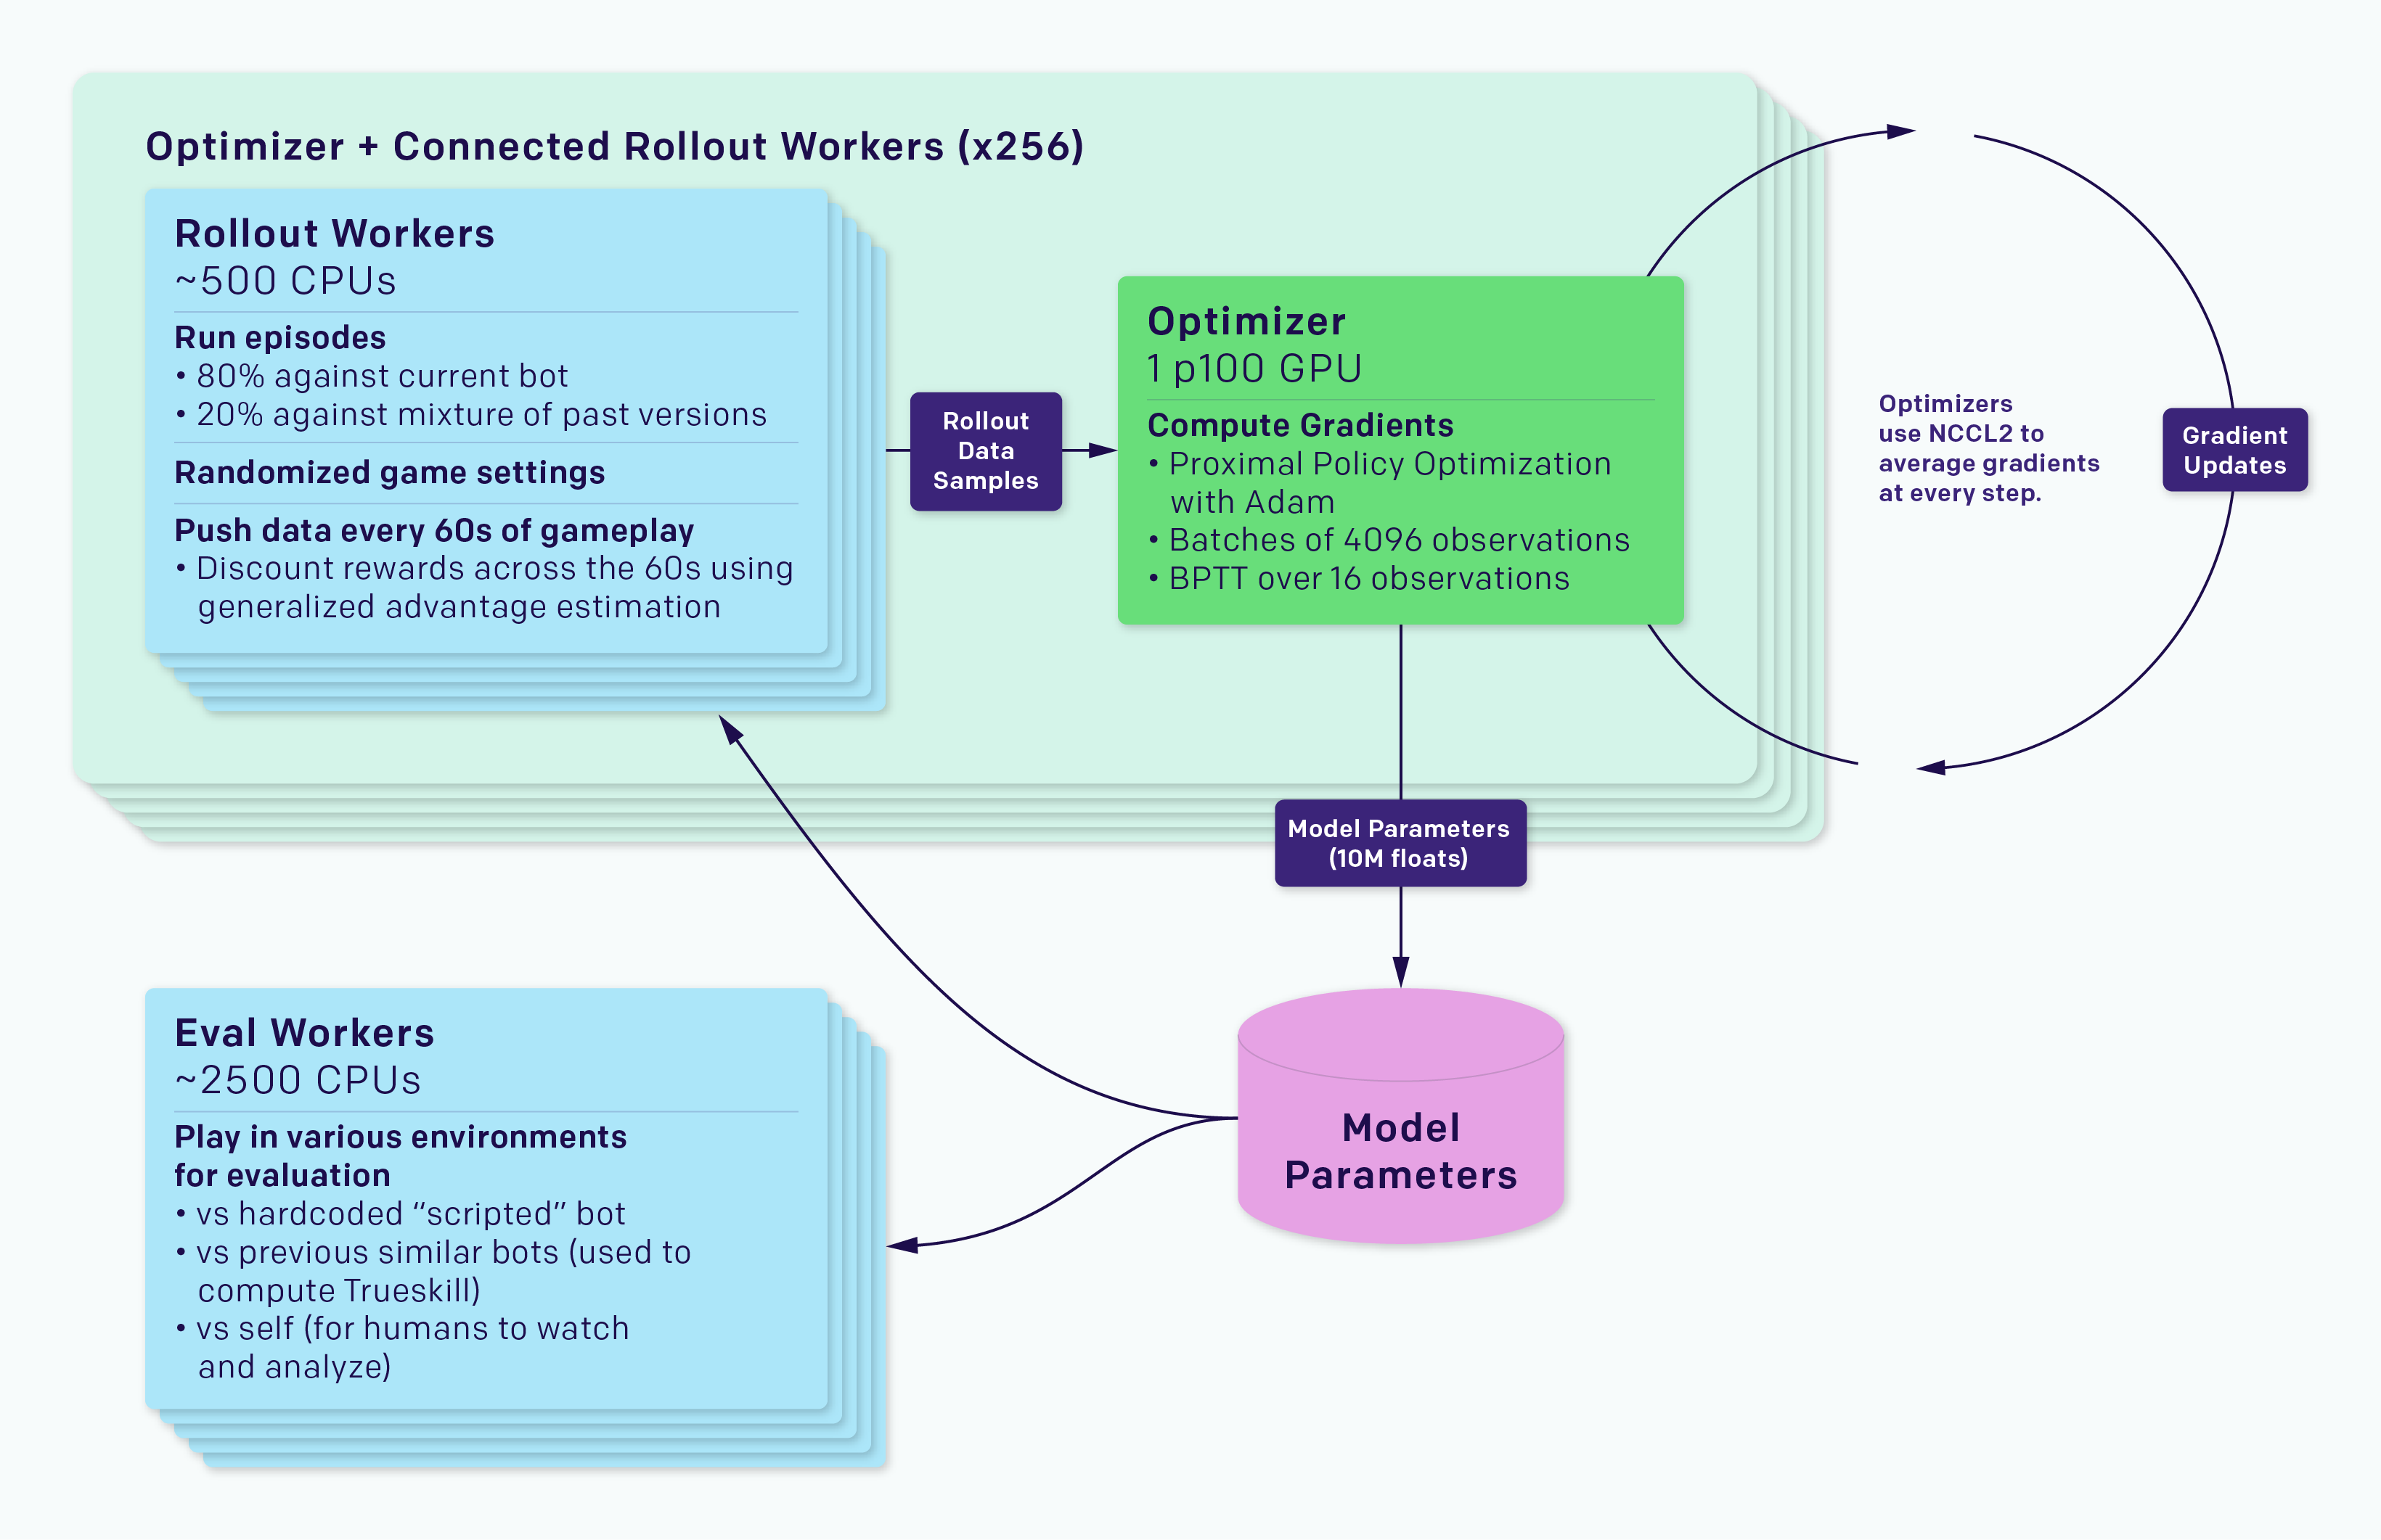
Example Use Cases of Reinforcement Learning
Gaming
OpenAI (2017) & OpenAI Five (2018)
Team-based agent learning in a game of DotA.
Key differences compared to other traditional game AI systems:
Long time horizons
DotA games run at 30 frames per second for an average of 45 minutes, resulting in 80,000 ticks per game.
Chess usually ends before 40 moves, Go before 150 moves, with almost every move being strategic.
Partially-observed state
The rest of the map is covered in a fog hiding enemies and their strategies.
High-dimensional, continuous action space
There are an average of ~1,000 valid actions each tick.
The average number of actions in chess is 35; in Go, 250.
High-dimensional, continuous observation space
The model observes the state of a DotA game as 20,000 numbers representing all information a human is allowed to access.
A chess board is naturally represented as about 70 enumeration values; a Go board as about 400 enumeration values.
Business, Marketing, and Advertising
OpenAI Model Training Rollout Architecture
Recommendation Systems
Approach
Massively-scaled version of Proximal Policy Optimisation.
LSTM Model for determining actions (each action head is computed independently).
Trained via OpenAI Rapid.
Science
OpenAI Five
Internal

Slide 8
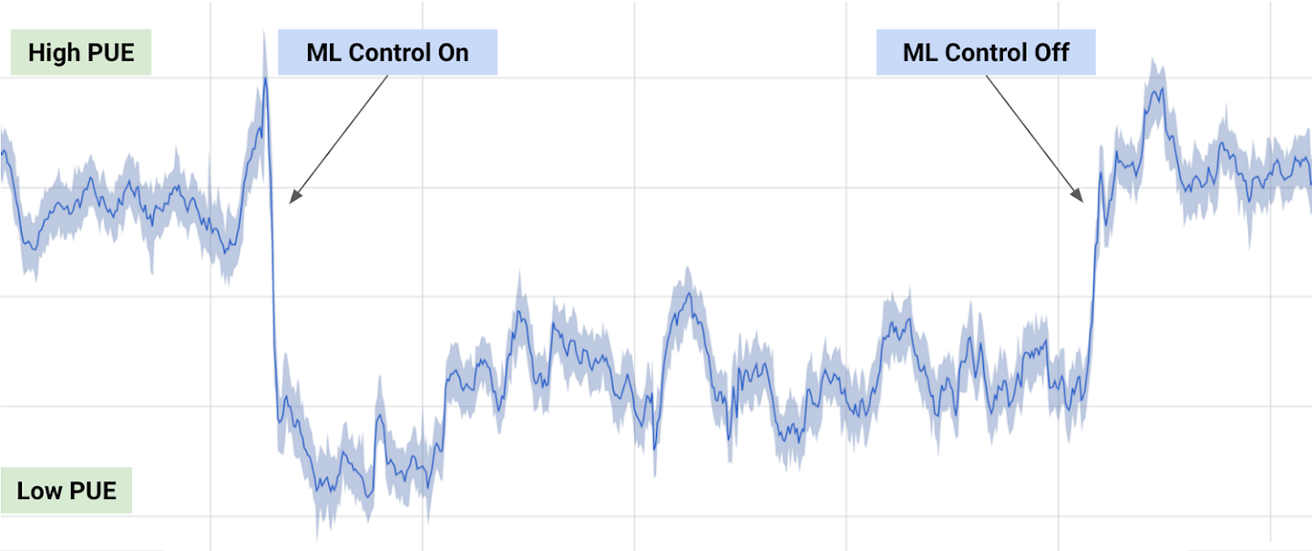
Example Use Cases of Reinforcement Learning
Gaming
Personalised Recommendations
Like, RL models can help companies analyse customer preferences and help in the better advertisement of the products.
Strategising
We know that business requires proper strategising. The steps need careful planning for a product or the company to gain profit.
RL here helps to devise proper strategies by analyzing various possibilities and by that; it tries to improve the profit margin in each result. Various multinational companies use these models. Also, the cost of these models is high.
Resource Management
Designing algorithms to allocate limited resources to different tasks is challenging and requires human-generated heuristics.
DeepMind AI Reduces Google Data Centre Cooling Bill by 40%
Business, Marketing, and Advertising
Recommendation Systems
Science
DeepMind AI Reduces Google Data Centre Cooling Bill by 40% | DeepMind
Internal

Slide 9
Example Use Cases of Reinforcement Learning
Gaming
RL is now a big help in recommendation systems like news, music apps, and web-series apps like Netflix, etc. These apps work as per customer preferences.
In the case of web-series apps like Netflix, the variety of shows that we watch become a list of preferences for the algorithm.
Companies like these have sophisticated recommendation systems. They consider many things like user preference, trending shows, related genres, etc. Then according to these preferences, the model will show you the latest trending shows.
"DRN: A Deep Reinforcement Learning Framework for News Recommendation“
News recommendations have always faced several challenges, including the dynamics of rapidly changing news, users who tire easily, and the Click Rate that cannot reflect the user retention rate.
The authors built four categories of resources: A) user resources, B) context resources such as environment state resources, C) user news resources, and D) news resources such as action resources.
The four resources were inserted into the Deep Q-Network (DQN) to calculate the Q value. A news list was chosen to recommend based on the Q value, and the user's click on the news was part of the reward the RL agent received.
Business, Marketing, and Advertising
Recommendation Systems
Science
Internal

Slide 10
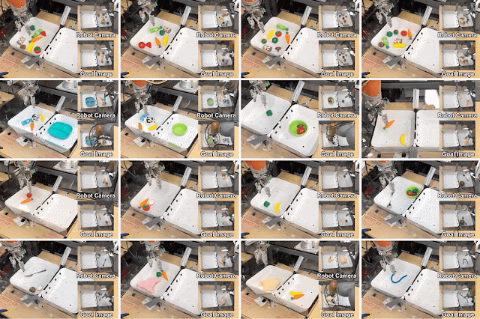
Example Use Cases of Reinforcement Learning
Gaming
Atomic Science
The most talked-about is in atomic science. Both the physics behind atoms and their chemical properties are researched.
Reinforcement learning helps to understand chemical reactions. We can try to have cleaner reactions that yield better products. There can be various combinations of reactions for any molecule or atom. We can understand their bonding patterns with machine learning.
Business, Marketing, and Advertising
Robotics
Robots with pre-programmed behavior are useful in structured environments, such as the assembly line of an automobile manufacturing plant, where the task is repetitive in nature.
In the real world, where the response of the environment to the behavior of the robot is uncertain, pre-programming accurate actions is nearly impossible. In such scenarios, RL provides an efficient way to build general-purpose robots.
e.g., robotic path planning
Potential for transfer learning.
Recommendation Systems
Science
Example tasks that MT-Opt is able to learn, such as instance and indiscriminate grasping, chasing, placing, aligning and rearranging.
Google AI Blog: Multi-Task Robotic Reinforcement Learning at Scale (googleblog.com)
Internal

Slide 11
Agenda
[Motivation] Is Reinforcement Learning Worth It?
Example Use Cases of Reinforcement Learning
Key Components of Reinforcement Learning
Reinforcement Learning Techniques
Q-Learning
SARSA
Deep Q-Network
Deep Deterministic Policy Gradient (DDPG)
OpenAI Gym – Framework for RL
Internal

Slide 12

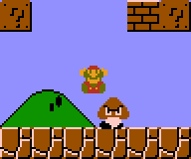

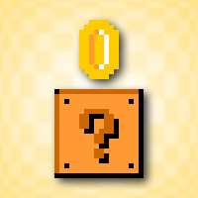
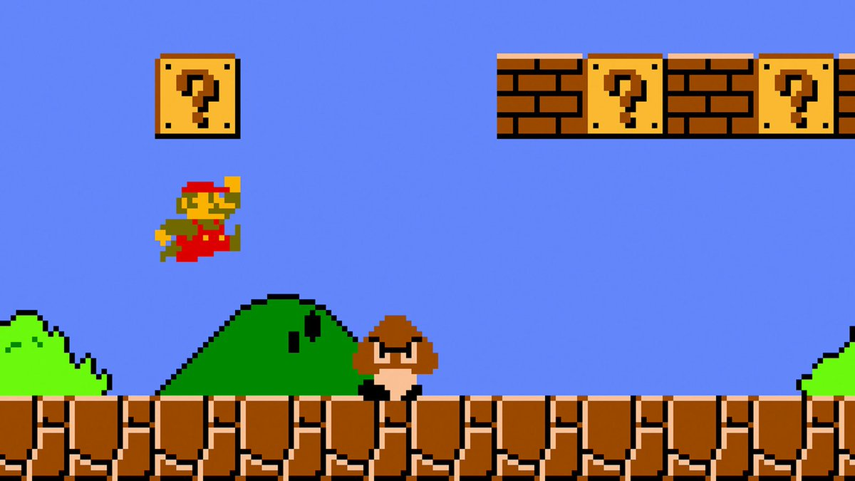
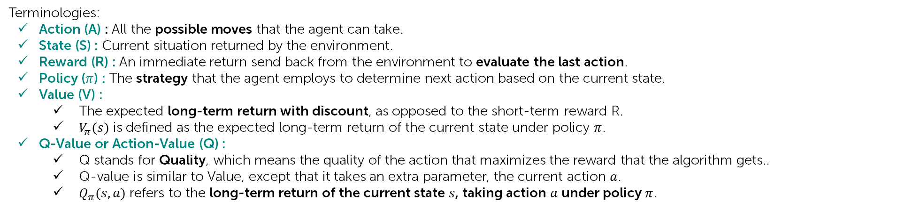
Key Components of Reinforcement Learning
Agent
-ve Reward
+ve Reward
Environment & State
The loop is repeated until the environment sends a terminal state, which ends the episode.
An episode is a “cycle” of a game, like a “run” of Super Mario until the character “dies” or reaches the end of a map (“reaches the flag”).
Terminologies:
Action (A) : All the possible moves that the agent can take.
State (S) : Current situation returned by the environment.
Reward (R) : An immediate return send back from the environment to evaluate the last action.
Policy ($π$) : The strategy that the agent employs to determine next action based on the current state.
Value (V) :
The expected long-term return with discount, as opposed to the short-term reward R.
$V_{π}(s)$ is defined as the expected long-term return of the current state under policy $π$.
Q-Value or Action-Value (Q) :
Q stands for Quality, which means the quality of the action that maximizes the reward that the algorithm gets..
Q-value is similar to Value, except that it takes an extra parameter, the current action $a$.
$Q_{π}(s,a)$ refers to the long-term return of the current state $s$, taking action $a$ under policy $π$.
Internal

Slide 13
Agenda
[Motivation] Is Reinforcement Learning Worth It?
Example Use Cases of Reinforcement Learning
Key Components of Reinforcement Learning
Reinforcement Learning Techniques
Q-Learning
SARSA
Deep Q-Network
Deep Deterministic Policy Gradient (DDPG)
OpenAI Gym – Framework for RL
Internal

Slide 14
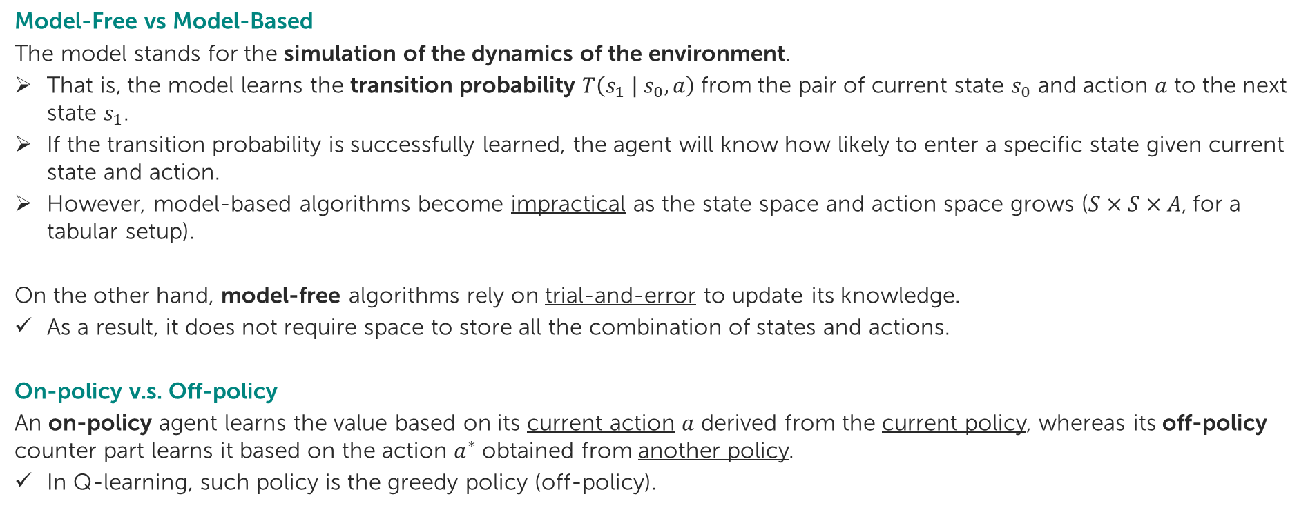
Reinforcement Learning Techniques General Variations of RL
Model-Free vs Model-Based
The model stands for the simulation of the dynamics of the environment.
That is, the model learns the transition probability $T\left(s_{1} | s_{0}, a\right)$from the pair of current state $s_{0}$ and action $a$ to the next state $s_{1}$.
If the transition probability is successfully learned, the agent will know how likely to enter a specific state given current state and action.
However, model-based algorithms become impractical as the state space and action space grows ($S×S×A$, for a tabular setup).
On the other hand, model-free algorithms rely on trial-and-error to update its knowledge.
As a result, it does not require space to store all the combination of states and actions.
On-policy v.s. Off-policy
An on-policy agent learns the value based on its current action $a$ derived from the current policy, whereas its off-policy counter part learns it based on the action $a^{∗}$ obtained from another policy.
In Q-learning, such policy is the greedy policy (off-policy).
Internal

Slide 15
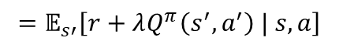
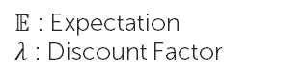
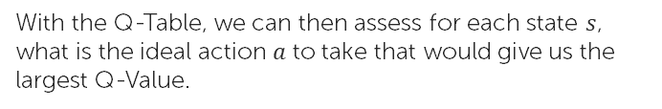
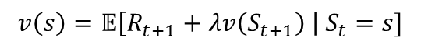
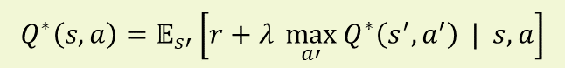
Reinforcement Learning Techniques (1) Q-Learning
Q-Learning is an off-policy (it is off-policy because the algorithm learns from random actions), model-free RL algorithm based on the well-known Bellman Equation:
$$v\left(s\right)=𝔼\left[R_{t+1}+λv\left(S_{t+1}\right) \right| S_{t}=s]$$
$𝔼$ : Expectation
$λ$ : Discount Factor
We can also re-write it in the form of Q-Value:
$$Q^{π}\left(s,a\right)=𝔼\left[r_{t+1}+λr_{t+2}+λ^{2}r_{t+3}+… | s, a\right]$$
$$=𝔼_{s′}\left[r+λQ^{π}\left(s^{′},a^{′}\right) | s, a\right]$$
The goal of Q-Learning would be to then maximise the Q-Value, with the optimal Q-Value, $Q^{∗}$ expressed as:
$$Q^{∗}\left(s,a\right)=𝔼_{s′}\left[r+λ \max_{a′}{Q^{∗}\left(s^{′},a^{′}\right)} | s,a\right]$$
When we code using this algorithm, we construct a reward matrix that stores reward at specific moves. Like if the reward is 100, then it will be stored in the matrix at the position where it got 100.
 | s1 | s2 | s3
a1 | 1 | 3 | 50
a2 | 2 | 100 | 4
a3 | 70 | 2 | 0
a4 | 2 | 9 | 3
With the Q-Table, we can then assess for each state $s$, what is the ideal action $a$ to take that would give us the largest Q-Value.
Internal

Slide 16
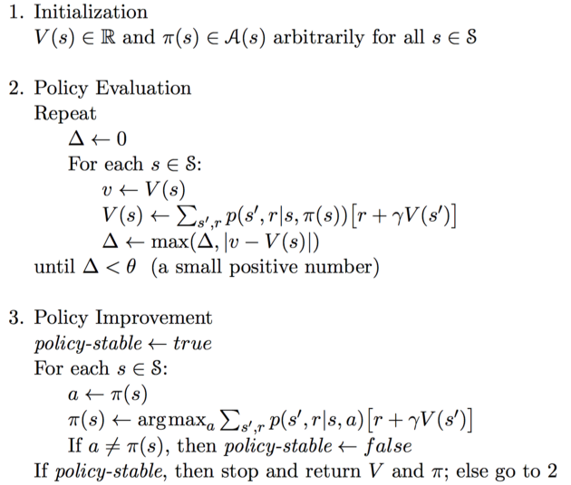
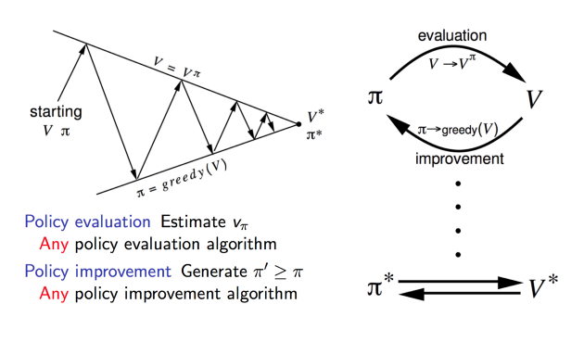
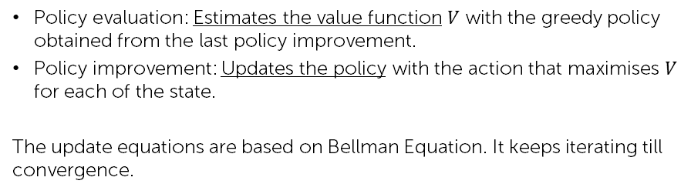
Reinforcement Learning Techniques (1) Q-Learning
Before going into the method of optimising the Q-Value, we need to first understand two value update methods that are closely related to Q-Learning.
Policy Iteration
Policy iteration runs a loop between policy evaluation and policy improvement.
Policy evaluation: Estimates the value function $V$ with the greedy policy obtained from the last policy improvement.
Policy improvement: Updates the policy with the action that maximises $V$ for each of the state.
The update equations are based on Bellman Equation. It keeps iterating till convergence.
Internal

Slide 17
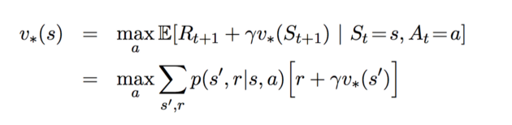
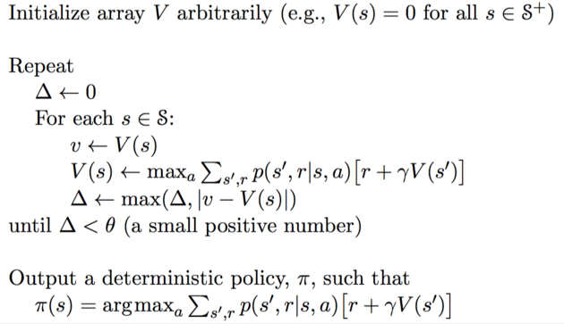
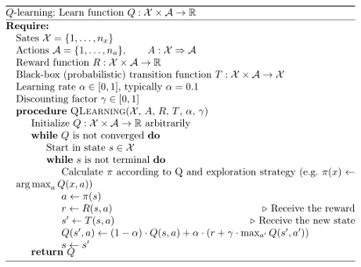
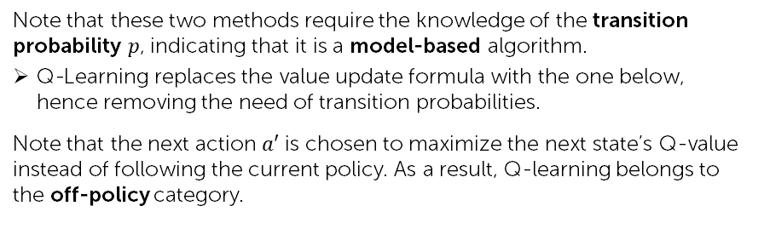
Reinforcement Learning Techniques (1) Q-Learning
Before going into the method of optimising the Q-Value, we need to first understand two value update methods that are closely related to Q-Learning.
Value Iteration
Identifying the Optimal Policy
Value Iteration only contains one component. It updates the value function $V$ based on the Optimal Bellman Equation.
Note that these two methods require the knowledge of the transition probability $p$, indicating that it is a model-based algorithm.
Q-Learning replaces the value update formula with the one below, hence removing the need of transition probabilities.
Note that the next action $a′$ is chosen to maximize the next state’s Q-value instead of following the current policy. As a result, Q-learning belongs to the off-policy category.
$α$ : learning rate (i.e., how fast we are approaching the goal)
After the iteration converges, the optimal policy is straight-forwardly derived by applying an argument-max function for all of the states.
Internal

Slide 18
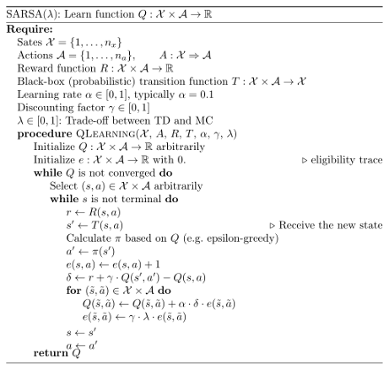
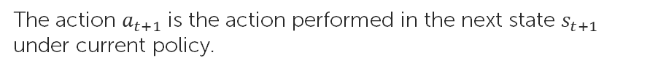
Reinforcement Learning Techniques (2) State-Action-Reward-State-Action (SARSA)
The SARSA algorithm has various similarities with the Q-learning approach, but the difference is that it is an on-policy method.
Therefore, it does not follow the greedy approach and it learns the Q-value from the current state and actions.
SARSA Update Equation
The action $a_{t+1}$ is the action performed in the next state $s_{t+1}$ under current policy.
Internal

Slide 19
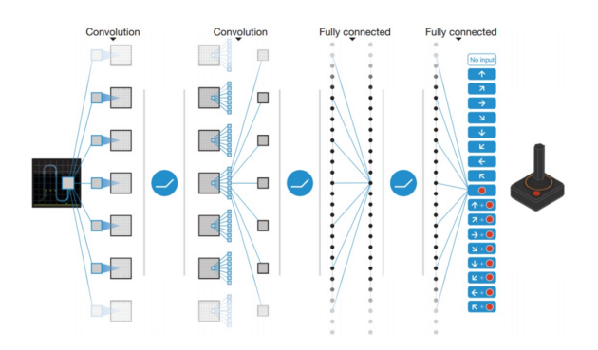
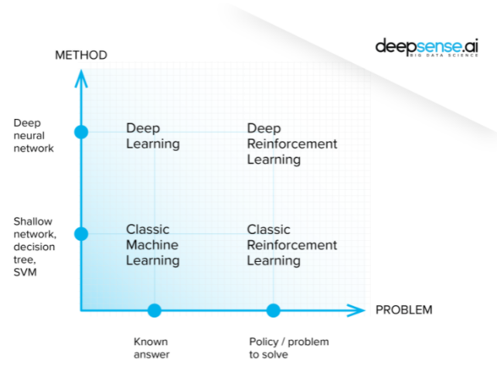
Reinforcement Learning Techniques (3) Deep Q-Network (DQN)
Although Q-learning is a very powerful algorithm, its main weakness is lack of generality.
This means that for states that the Q-learning agent has not seen before, it has no clue which action to take.
To deal with this problem, DQN get rid of the two-dimensional array by introducing Neural Network.
One common misconception is that Reinforcement Learning always involves Deep Learning, but that is not the case!
Deep Q-Network is a specific RL technique which combines Deep Learning with RL to learn its own Q-Values.
DQN uses a neural network instead of the two-dimensional array to estimate the Q-value function.
DQN Atari Example
Internal

Slide 20
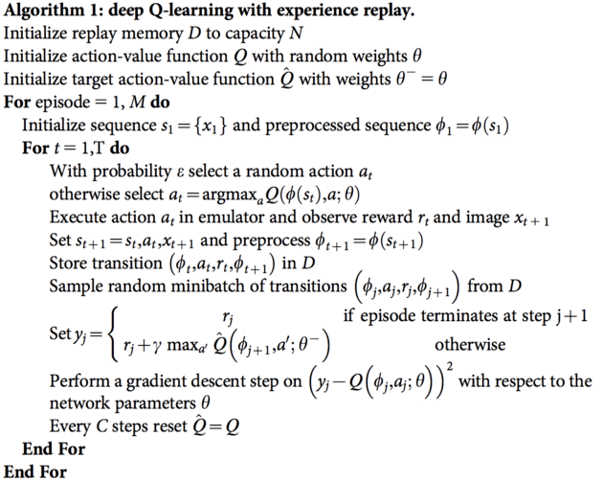
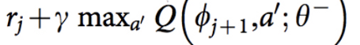
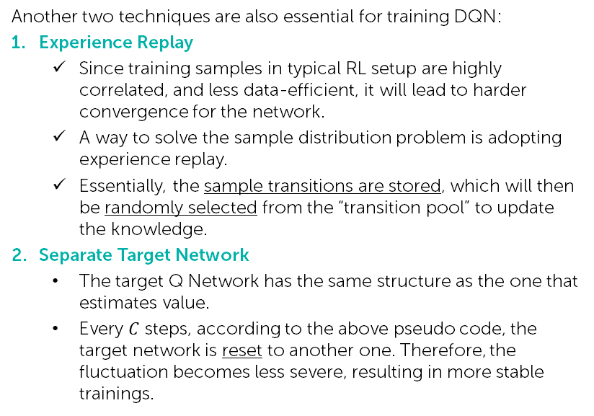
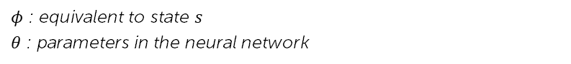
Reinforcement Learning Techniques (3) Deep Q-Network (DQN)
How do we train the network?
The network is trained based on the Q-Learning update equation.
The loss function is defined as the Squared Error between the target Q-Value and the Q-Value output from the network.
Target Q-Value for Q-Learning
$φ$ : equivalent to state $s$
$θ$ : parameters in the neural network
Another two techniques are also essential for training DQN:
Experience Replay
Since training samples in typical RL setup are highly correlated, and less data-efficient, it will lead to harder convergence for the network.
A way to solve the sample distribution problem is adopting experience replay.
Essentially, the sample transitions are stored, which will then be randomly selected from the “transition pool” to update the knowledge.
Separate Target Network
The target Q Network has the same structure as the one that estimates value.
Every $C$ steps, according to the above pseudo code, the target network is reset to another one. Therefore, the fluctuation becomes less severe, resulting in more stable trainings.
Internal

Slide 21
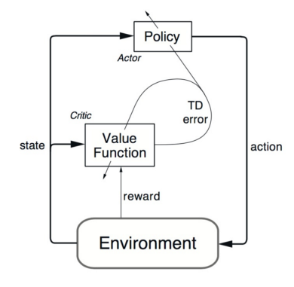
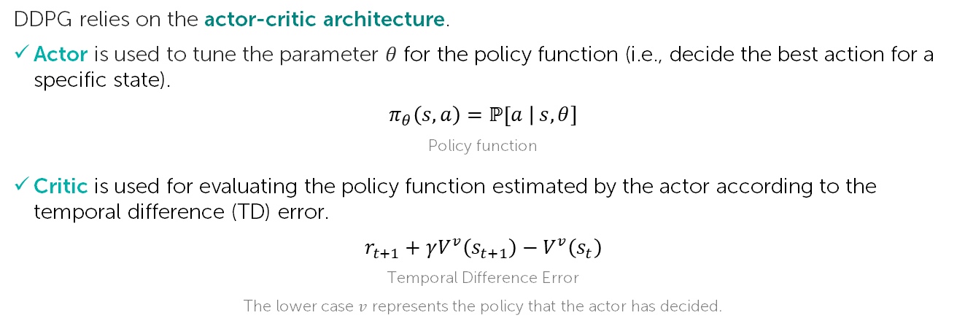
Reinforcement Learning Techniques (4) Deep Deterministic Policy Gradient (DDPG)
DQN has a limitation – the action space of DQN is discrete.
However, many tasks of interest, especially physical control tasks, have a continuous action space.
If you discretise the action space too finely, you wind up having an action space that is too large.
For instance, assume the degree of free random system is 10. For each of the degree, you divide the space into 4 parts. You wind up having 4¹⁰ = 1048576 actions. It is also extremely hard to converge for such a large action space.
DDPG relies on the actor-critic architecture.
Actor is used to tune the parameter $θ$ for the policy function (i.e., decide the best action for a specific state).
$$π_{θ}\left(s,a\right)=ℙ\left[a \right| s, θ]$$
Policy function
Critic is used for evaluating the policy function estimated by the actor according to the temporal difference (TD) error.
$$r_{t+1}+γV^{v}\left(s_{t+1}\right)−V^{v}\left(s_{t}\right)$$
Temporal Difference Error
The lower case $v$ represents the policy that the actor has decided.
Internal

Slide 22
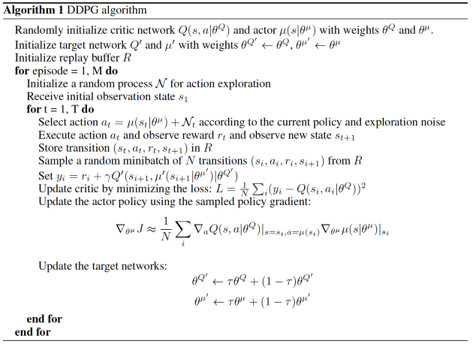
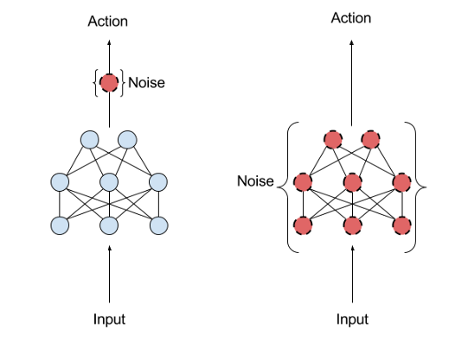
Reinforcement Learning Techniques (4) Deep Deterministic Policy Gradient (DDPG)
DDPG also borrows the ideas of experience relay and separate target network from DQN.
Another issue for DDPG is that it seldom performs exploration for actions.
A solution for this is adding noise on the parameter space or action space.
A paper from OpenAI claims that adding noise to parameter space is more beneficial than action space.
Action Noise
Parameter Noise
Internal

Slide 23
Agenda
[Motivation] Is Reinforcement Learning Worth It?
Example Use Cases of Reinforcement Learning
Key Components of Reinforcement Learning
Reinforcement Learning Techniques
Q-Learning
SARSA
Deep Q-Network
Deep Deterministic Policy Gradient (DDPG)
OpenAI Gym – Framework for RL
Internal

Slide 24
References
Introduction to Various Reinforcement Learning Algorithms. Part I (Q-Learning, SARSA, DQN, DDPG) | by Kung-Hsiang, Huang (Steeve) | Towards Data Science
Reinforcement Learning Algorithms and Applications – TechVidvan
What is Reinforcement Learning? – Overview of How it Works | Synopsys
Reinforcement learning - GeeksforGeeks
Internal

Slide 25
Thank you
Internal

